Slide 1

Should Writing Fake News Be Considered a Crime?
Debate

Slide 2
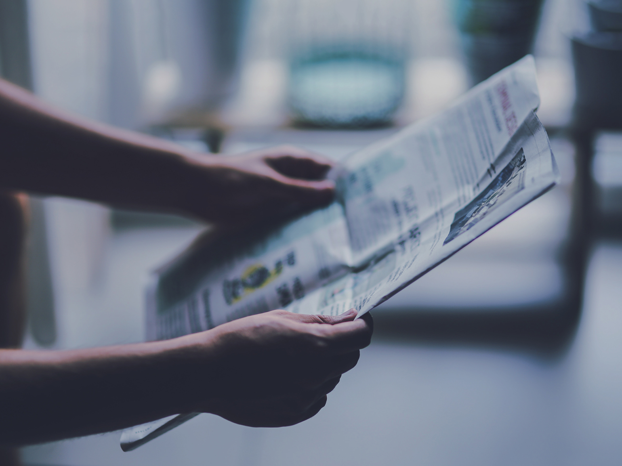
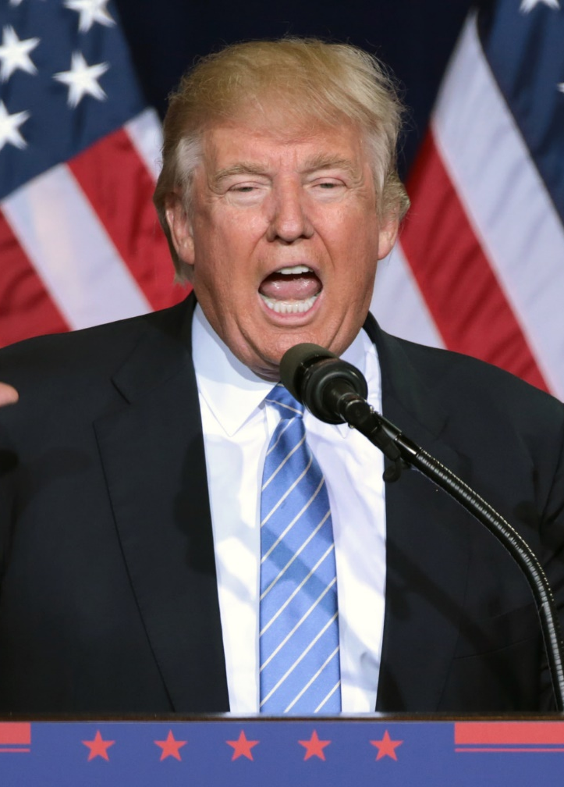
Fake News: The Context
Since Donald Trump first popularised the phrase during the 2016 US presidential election, the definition of ‘Fake News’ has broadened. The phrase now defines false or misleading news designed to damage politicians, political parties, individuals, companies and groups of people.
Fake news is a serious concern for social media companies like Facebook, who say they are trying to reduce the spread of misinformation on their website. Many have warned that fake news may have real-world consequences such as political extremism and violence.
At present, creating fake news has little consequence for its writers and in some cases, makes them a lot of money via social media. Should writing/spreading fake news be a crime?

Slide 3
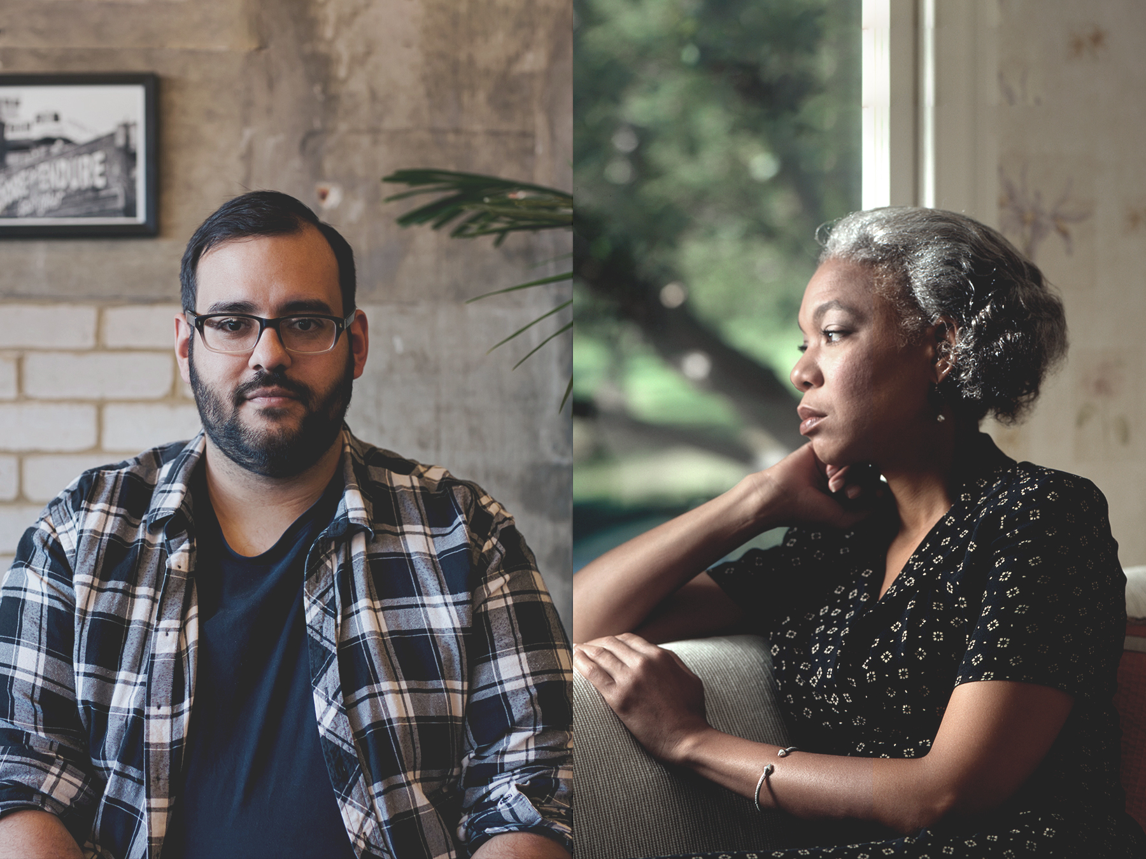
What Do You Think?
“Making fake news illegal is a difficult thing to do as matters of opinion don’t need to be based upon facts – simply emotions or our morals. If we make fake news illegal, what’s to say a government wouldn’t then ban anything criticising or opposing them in order to silence those who don’t agree with them?”
“Fake news is an incredibly dangerous thing. Writing, spreading or promoting fake news should be considered a criminal activity. All it takes is one particularly angry individual to read a fake news article and act upon it with threats of violence or worse.”
Who do you agree
with? Why?
What Do You Think?
Who do you agree with? Why?

Slide 4
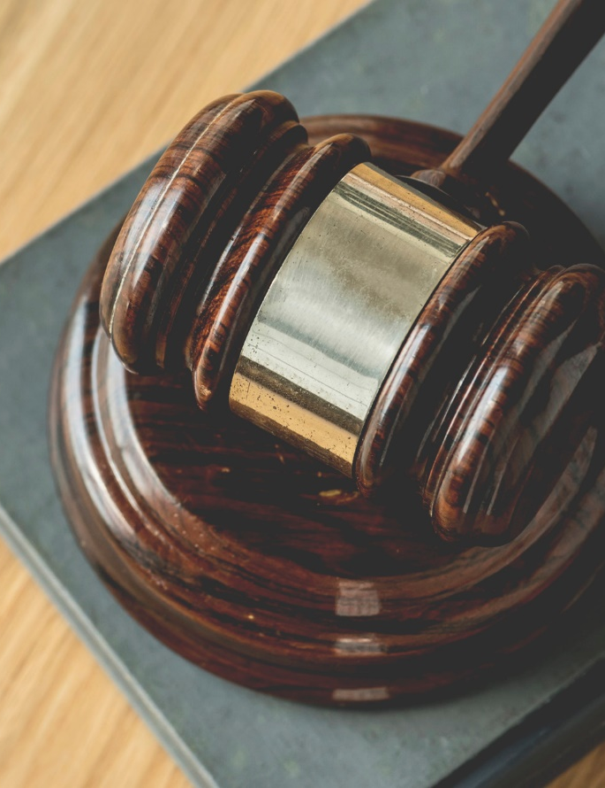
For and Against
Fake news has the potential to harm individuals, groups of people, politicians and companies. Stopping writers producing the content and stopping individuals sharing it is difficult as there are very few specific laws surrounding
fake news.
Imagine that the government were to make writing and sharing fake news illegal. What are the problems with doing this? What are the benefits?

Slide 5

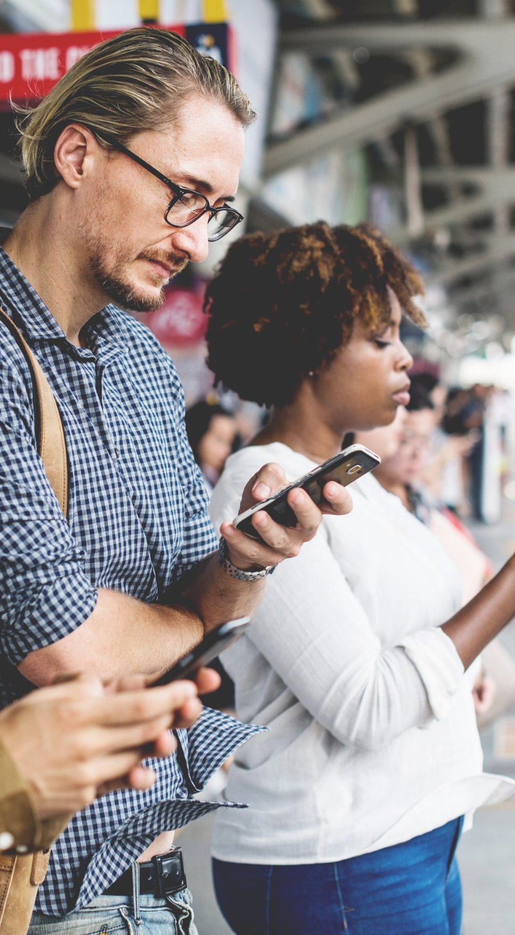
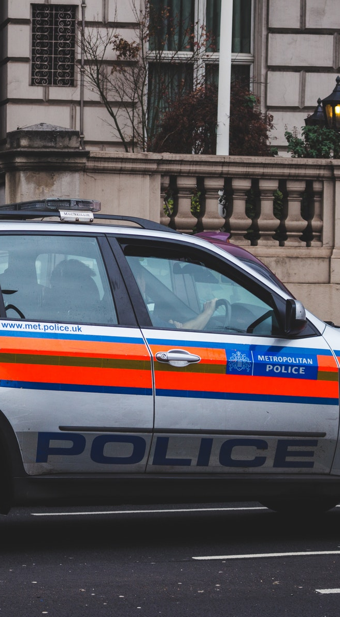
Action Plan
An international social media company are struggling with fake news being shared on their services and are looking for ideas to stem the flow of false information being shared.
Work with others in your group to create an action plan that will help them stop fake news.

Slide 6
The Big Question:
Should Writing Fake News Be
Considered a Crime?
Working with your group, prepare a speech or presentation to tackle the question above. Consider the pros and cons and come to a conclusion that you can present to the rest of your class.

Slide 7


